Slide 1

FEDERAL MINISTRY OF FINANCE, BUDGET AND NATIONAL PLANNING
National Council on Finance and Economic Development
Theme – Public Sector Finance Management In the New Normal (Post COVID- 19)
Proposed Date: October/November, 2021
Mode- Hybrid
Venue: Abuja/Any Suitable State

Slide 2
CONTENTS
01
BACKGROUND/CHALLENGES
02
APPROACH/METHODOLOGY
03
CONFERENCE DELIVERABLES/OUTCOMES
04
SUMMARY OF TOPICS
05
FACILITATORS/SPEAKERS
Notes:
© Copyright Showeet.com

Slide 3

National Council on Finance and Economic Development
Understanding of Your Needs (1/2)
BACKGROUND
The Nigerian economy went into a recession in 2020, reversing three years of recovery, due to fall in crude oil prices on account of falling global demand and containment measures to fight the spread of COVID–19.
According to the National Bureau of Statistics (NBS), the country’s inflation rose to 12.8% in 2020 from 11.4% in 2019, fueled by higher food prices due to constraints on domestic supplies and the pass-through effects of an exchange rate premium that widened to about 24%.
Also, the removal of fuel subsidies and an increase in electricity tariffs added further to inflationary pressures across board. The Central Bank of Nigeria responded by reducing the Monetary Policy Rate by 100 basis points to 11.5% to shore up a flagging economy. The fiscal deficit, financed mostly by domestic and foreign borrowing, widened to 5.2% in 2020 from 4.3% in 2019, reflecting pandemic-related spending pressures and revenue shortfalls.
Total public debt stood at $85.9 billion (25% of GDP) on 30 June 2020, 2.4% higher than a year earlier. Domestic debt represented 63% of total debt, and external debt, 37%. High debt service payments, estimated at more than half of federally collected revenues, pose a major fiscal risk to Nigeria. The current account position was expected to remain in deficit at 3.7% of GDP, weighed down by the fall in oil receipts and weak external financial flows.
Though the impact of the recession was short-lived due to the proactive measures put in place by the Federal Government, this experience calls for an urgent strategy to develop a more resilient and sustainable economy model that could stand the test of time.

Slide 4
National Council on Finance and Economic Development
Understanding of Your Needs (2/2)
THE CHALLENGE
According to the 2021 report released by the African Development Bank Group (AfDB), Nigeria’s public debt is relatively sustainable at 25% of GDP. However, debt service payments are high, and the country’s ability to attract external private financial flows is hurt by macroeconomic imbalances and policy uncertainty.
During the first half of 2020, Nigeria received $7.1 billion in foreign investment. This was half the amount it received in the corresponding period of 2019. Nigeria’s financing requirements require improved domestic revenue collection.
Currently, non-oil revenue collections are equivalent to 4% of GDP. The revenue yield in 2020 from an increase in the Value Added Tax rate to 7.5% from 5% was less than projected because of subdued economic activities. In the current year, remittances to the Federation Account had been substantially threatened by declining/zero contribution from some Revenue Generating Agencies. Insecurity in some geo-political zones of the country pose grave threat to conducive environment for productive endeavours and hinder Foreign Direct Investment.
To reverse the current trend, there is a critical need to holistically evaluate the challenges affecting Nigeria’s economic growth and articulate policies to address the situation. The hosting of the National Council on Finance and Economic Development provides an appropriate platform for such discourse .
This conference aims to provide an opportunity to discuss issues bordering on improving accountability in government, minimizing waste & leakages, enhancing internally generated revenue (IGR), driving fiscal discipline, and understanding key growth constraints. The conference also aims to discuss key learnings from public finance management policy experiences in other countries and drive an all-inclusive economic framework that would champion the interest of both the Federal and Sub-national levels of the Nigerian Governments towards ensuring sustainable growth in the post-COVID era.
Participants at the conference will reflect on the state of the Nigerian economy – including the security architecture & public finance management challenges, with the strategic objective of articulating policy solutions required to drive the country’s future economic growth projections
.

Slide 5

National Council on Finance & Economic Development
Solution (1/2)
Approach/Methodology
Blended approach to action learning with case studies and simulations
2-Day Programme
Facilitated by Renowned Subject Matter Experts & Public Sector Practitioners
Reflect on the state of the economy and share solutions required to fast-track Nigeria’s Economic Recovery during & Post- Covid 19
Expose the Economic Management Team (Federal and Sub-national) to strategies for solving the myriads of economic development challenges facing the country
Transform the economic management view of the Public Sector Finance Mangers
5

Slide 6
National Council on Finance & Economic Development
Solution (2/2)
Program Deliverables/ Outcomes
The Conference is expected to deliver the following outcomes::
Key strategies to Improve Accountability and Transparency in Government.
Understanding global best practices in minimising financial waste and leakages in Government.
Strategies required to enhance Internally Generated Revenue (IGR).
Strategies for sustaining the gains of States Fiscal Transparency Accountability Sustainability Programme (SFTAS)
Collaborative strategies for promoting internal security in Nigeria.
Innovative methodologies for identifying and executing new opportunities for value creation in Government
6

Slide 7
National Council on Finance & Economic Development
Summary of Topics (1/3)
S/N | TOPICS | SCOPE/OBJECTIVE
01 | Delivery of Good Governance at National & Sub-national levels- a focus on international best practice and the keys for getting things done – Purpose; Funding; People; Planning; KPI’s; and, Governance | This module will be facilitated with the intention of driving home to the participants the importance of what it takes to Get Things Done. Leveraging international best practices, the focus shall be how to identify and drive robust policy solutions towards good governance. | Peter Obi (Former Governor, Anambra State) Adedoyin Salami Senior Fellow/Associate Professor Lagos Business School. Member, Monetary Policy Committee (CBN) Ahmed Rufai Abubakar (Director General, Nataional Intelligence Agency. NIA)
02 | Strategic Control & Strategies for Improving Internally Generated Revenue – a focus on Budget stabilisation, effective Expenditure management and strategies for improving IGR | Participants will identify strategies for efficient and effective mobilisation of Internally Generated Revenue, and also learn how the application of strategic control can transform the nation’s economy
03 | National Security and sustainable economic development in Nigeria: Prospects and Challenges | This module will focus on examining the various security challenges in Nigeria, and proffering strategies for tackling them including the role of defense, rule-of-law, national security architecture and how they impact economic growth and development of Nigeria

Slide 8
National Council on Finance & Economic Development
Summary of Topics (2/3)
S/N | Module | Module Description
04 | Rethinking Economic Diversification in Nigeria – a focus on understanding the challenges of value exportation. | This module will be facilitated with the intention of driving home to the participants the challenges of mono-economies like Nigeria in the New Normal. Participants will also gain insights into the immense opportunities that abound in value exportation across several non-oil sectors. | Dr. Ngozi Okonjo Iweala Director General, World Trade Organization- WTO Patience Oniha Director General, Debt Management Office- DMO Ben Akabueze Director General, Budget Office of the Federation- BOF
05 | Understanding Debt Management in Nigeria: The Problems and Solution | This module intends to examine in detail the key challenges of debt management and how they affect the Nigerian economy and proffer effective debt management strategies .
06 | Understanding the role of effective public sector Planning, budgeting and budget monitoring | Understanding the planning process, effective public sector budgeting, including the monitoring and evaluation as well as aligning Federal and Sub-national Plans for sustainable development.

Slide 9
National Council on Finance & Economic Development
Summary of Topics (3/3)
S/N | Module | Module Description
07 | Sustaining the Ideals of States Fiscal Transparency Accountability & Sustainability (SFTAS) Programme. | Participants will identify strategies for sustaining the gains of the States Fiscal Transparency Accountability & Sustainability (SFTAS) Programme | WORLD BANK
08 | Public Finance Implications of the emerging autonomy of States’ Legislative and Judiciary arms of government | To appraise the public finance implication of the emerging autonomy of States’ Legislative and Judiciary arms of government and develop templates for accounting in the Federal and State levels | Ahmed Idris Accountant-General of the Federation
09 | Challenges of Revenue Generation and Management of the Federation Account | The paper will discuss current issues, challenges and prospects of revenue generation in Nigeria and provide clear understanding on the linkage between Fiscal Federalism and the Operation of the Federation Account | Dr. M.K. Dikwa Retired Federal Perm. Sec.

Slide 10
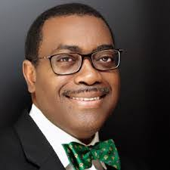
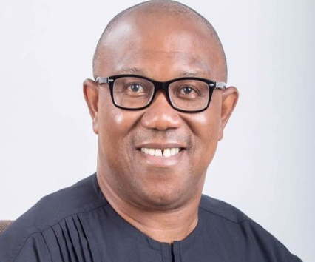
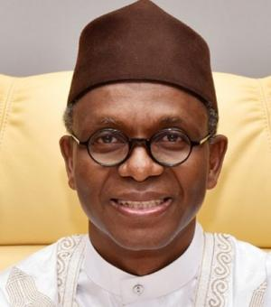
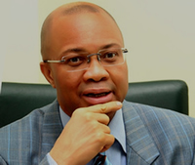
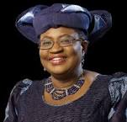
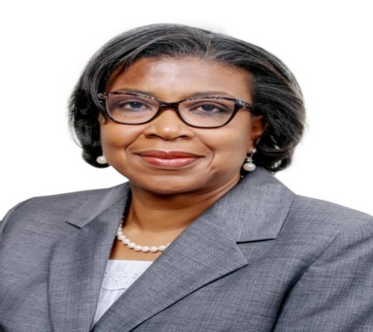
National Council on Finance & Economic Development
Facilitators/Speakers
Keynote Speaker
Speaker
Chairman of Session
Speaker
Speaker
Speaker
Akinwumi Adesina
[President of the African Development Bank]
Peter Obi
[Former Governor of Anambra State]
Mallam Nasir El Rufai
[Governor of Kaduna State]
Ben Akabueze
[Director-General, World Budget Office of the Federation]
Ngozi Okonjo-Iweala
[Director-General of the World Trade Organisation]
Patience Oniha
[Director General, Debt Management Office- DMO]

Slide 11
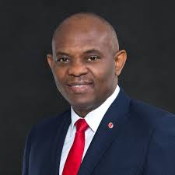
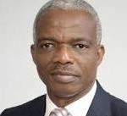
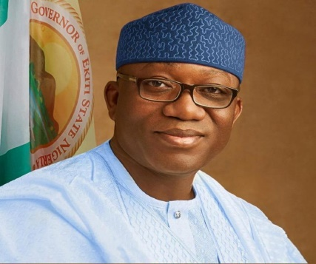
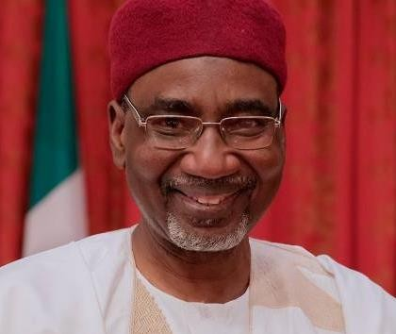
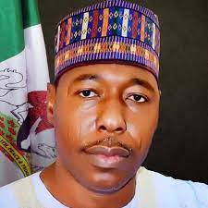
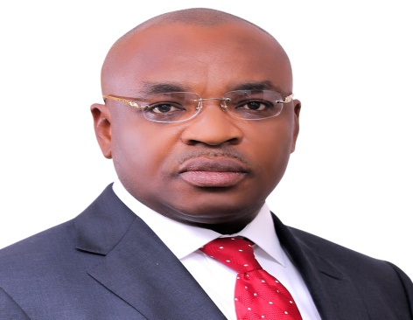
National Conference on Economic Growth & Development
Facilitators/Speakers
Speaker
Speaker
Chairman of Session
Speaker
Chairman of Session
Chairman of Session
Tony Elumelu
[Nigerian Economist, Entrepreneur, & Chairman United Bank for Africa]
Adedoyin Salami
[Renowned Economist & Chairman, Economic Advisory Council – EAC]
Kayode Fayemi
[Governor of Ekiti State]
Ahmed Rufai, Abubakar
[Director General of the National Intelligence Agency – NIA]
Babagana Umara Zulum
[Governor of Borno State]
Udom Gabriel Emmanuel
[Governor of Akwa-Ibom State]

